Slide 1
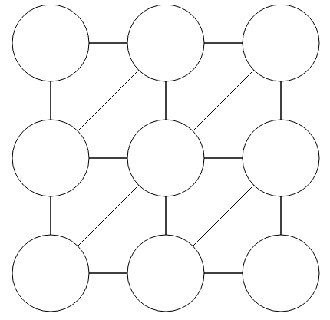
CSP Warm-up
Assign Red, Green, or Blue
Neighbors must be different
Sudoku
1
2
1
3
4
What is your brain doing to solve these?
How would you solve these with search (BFS, DFS, etc.)?
Notes:
Demo:
CS188 javascript demos -> source -> exercises -> csps -> CSPs demos -> CSPs demos.html
Settings:
Graph = Complex
Algorithm = Backtracking
Ordering = MRV
Filtering = Forward Checking
Solves already without any need for backtracking
Note: need a bigger problem to illustrate relevance of backtracking+AC+MRV+MCV

Slide 2

AI: Representation and Problem Solving
Constraint Satisfaction Problems (CSPs)
Instructors: Pat Virtue & Stephanie Rosenthal
Slide credits: Pat Virtue, http://ai.berkeley.edu

Slide 3
Announcements
HW3 due Wednesday!
P1 due Thursday, you can work in pairs!
Watch your time management!

Slide 4


What is Search For?
Planning: sequences of actions
The path to the goal is the important thing
Paths have various costs, depths
Heuristics give problem-specific guidance
Identification: assignments to variables
The goal itself is important, not the path
All paths at the same depth (for some formulations)
CSPs are specialized for identification problems

Slide 5

Constraint Satisfaction Problems

Slide 6


Constraint Satisfaction Problems
Standard search problems:
State is a “black box”: arbitrary data structure
Goal test can be any function over states
Successor function can also be anything
Notes:
Goal test has structure, it ‘s more like a manual describing a set of constraints that have to hold true

Slide 7
Constraint Satisfaction Problems
Standard search problems:
State is a “black box”: arbitrary data structure
Goal test can be any function over states
Successor function can also be anything
Constraint satisfaction problems (CSPs):
A special subset of search problems
State is defined by variables X_{i} with values from a domain D (sometimes D depends on i)
Goal test is a set of constraints specifying allowable combinations of values for subsets of variables
Notes:
Goal test has structure, it ‘s more like a manual describing a set of constraints that have to hold true

Slide 8
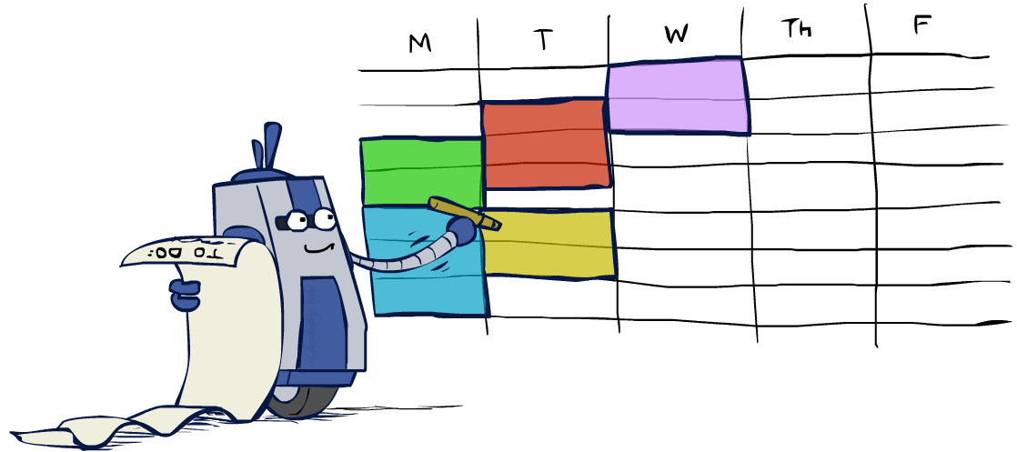
Real-World CSPs
Assignment problems: e.g., who teaches what class
Timetabling problems: e.g., which class is offered when and where?
Hardware configuration
Transportation scheduling
Factory scheduling
Circuit layout
Fault diagnosis
… lots more!
Many real-world problems involve real-valued variables…

Slide 9
Shelf Organization
The shelves that store products that will be shipped to you (e.g., Amazon) are optimized so that items that ship together are stored on the same shelf.

Slide 10
CSP Examples

Slide 11


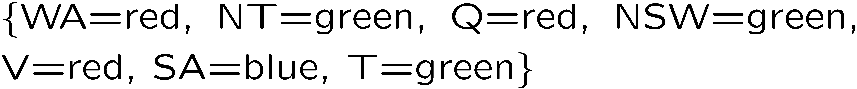
Example: Map Coloring
Variables:
Domains:
Constraints: adjacent regions must have different colors
Solutions are assignments satisfying all constraints, e.g.:
Implicit:
Explicit:

Slide 12
Constraint Graphs

Slide 13
Constraint Graphs
Binary CSP: each constraint relates (at most) two variables
Binary constraint graph: nodes are variables, arcs show constraints
General-purpose CSP algorithms use the graph structure to speed up search. E.g., Tasmania is an independent subproblem!
[Demo: CSP applet (made available by aispace.org) -- n-queens]
Notes:
Demo:
Run constraint.jar or constraint.exe, load the 5 queens problem.
Demo is just showing the n-queens applet as illustration of constraint graph, but later in lecture we’ll interact with the applet.
aispace.org will have the latest version

Slide 14

Varieties of CSPs and Constraints

Slide 15
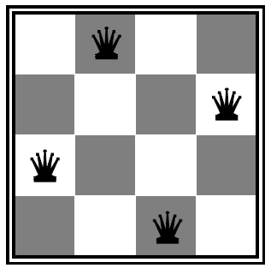

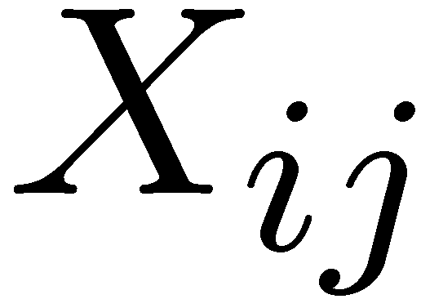

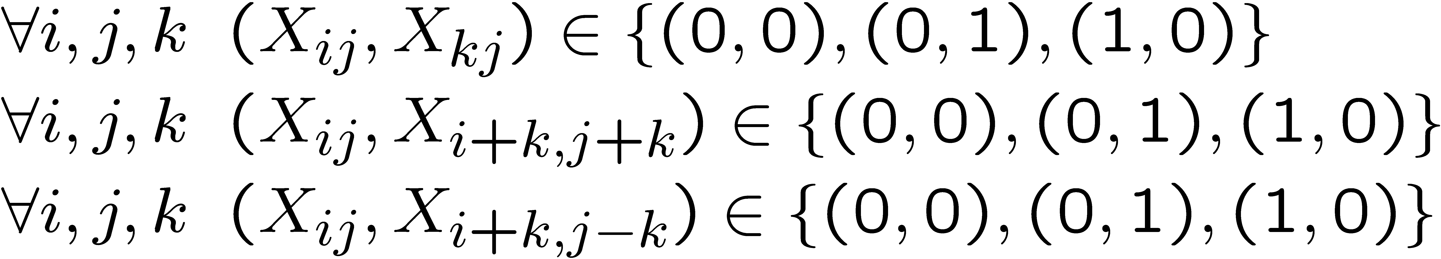
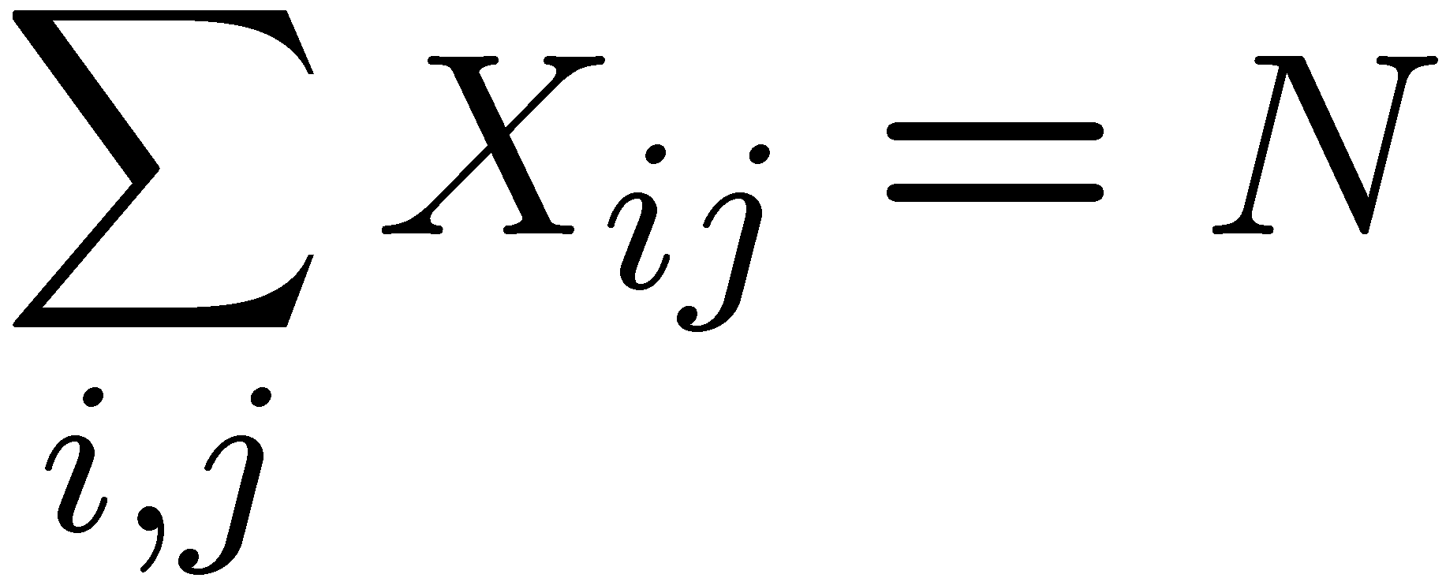
Example: N-Queens
Formulation 1:
Variables:
Domains:
Constraints

Slide 16







Example: N-Queens
Formulation 2:
Variables:
Domains:
Constraints:
Implicit:
Explicit:

Slide 17


Example: Cryptarithmetic
Variables:
Domains:
Constraints:
Notes:
0=7, R=4, W=6, U=2, T=8, F=1; 867 + 867 = 1734

Slide 18
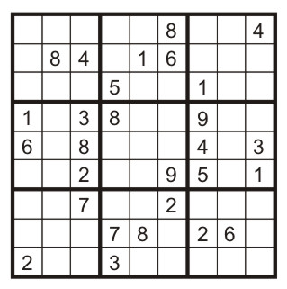
Example: Sudoku
Variables:
Each (open) square
Domains:
{1,2,…,9}
Constraints:
9-way alldiff for each column
9-way alldiff for each row
9-way alldiff for each region
(or can have a bunch of pairwise inequality constraints)

Slide 19


Varieties of CSPs
Discrete Variables
Finite domains
Size d means O(d^{n}) complete assignments
E.g., Boolean CSPs, including Boolean satisfiability (NP-complete)
Infinite domains (integers, strings, etc.)
E.g., job scheduling, variables are start/end times for each job
Linear constraints solvable, nonlinear undecidable
Continuous variables
E.g., start/end times for Hubble Telescope observations
Linear constraints solvable in polynomial time by LP methods

Slide 20


Varieties of Constraints
Varieties of Constraints
Unary constraints involve a single variable (equivalent to reducing domains), e.g.:
Binary constraints involve pairs of variables, e.g.:
Higher-order constraints involve 3 or more variables:
e.g., cryptarithmetic column constraints
Preferences (soft constraints):
E.g., red is better than green
Often representable by a cost for each variable assignment
Gives constrained optimization problems
(We’ll ignore these until we get to Bayes’ nets)

Slide 21

Solving CSPs

Slide 22
Standard Search Formulation
Standard search formulation of CSPs
States defined by the values assigned so far (partial assignments)
Initial state: the empty assignment, {}
Successor function: assign a value to an unassigned variable
Goal test: the current assignment is complete and satisfies all constraints
We’ll start with the straightforward, naïve approach, then improve it

Slide 23
Breadth First Search
… All possible first variables
Check: Is there a solution?

Slide 24
Breadth First Search

Slide 25
Breadth First Search

Slide 26
Breadth First Search
…

Slide 27
Depth First Search
…
…

Slide 28
Demo

Slide 29
What is wrong with general search?
When do you fail?

Slide 30

Backtracking Search

Slide 31
Backtracking Search
Backtracking search is the basic uninformed algorithm for solving CSPs
Idea 1: One variable at a time
Variable assignments are commutative, so fix ordering
I.e., [WA = red then NT = green] same as [NT = green then WA = red]
Only need to consider assignments to a single variable at each step
Idea 2: Check constraints as you go
I.e. consider only values which do not conflict previous assignments
Might have to do some computation to check the constraints
“Incremental goal test”
Depth-first search with these two improvements
is called backtracking search (not the best name)
Can solve n-queens for n ≈ 25

Slide 32
Backtracking Example

Slide 33
Backtracking Search
Notes:
Demo:
CS188 javascript demos -> source -> exercises -> csps -> CSPs demos -> CSPs demos.html
Settings:
Graph = Simple
Algorithm = Backtracking
Ordering = None
Filtering = None

Slide 34
Backtracking Search
General Search checks consistency on full assignment
Notes:
Demo:
CS188 javascript demos -> source -> exercises -> csps -> CSPs demos -> CSPs demos.html
Settings:
Graph = Simple
Algorithm = Backtracking
Ordering = None
Filtering = None

Slide 35
Backtracking Search
Backtracking Search checks consistency at each assignment
Notes:
Demo:
CS188 javascript demos -> source -> exercises -> csps -> CSPs demos -> CSPs demos.html
Settings:
Graph = Simple
Algorithm = Backtracking
Ordering = None
Filtering = None

Slide 36
Backtracking Search
Backtracking = DFS + variable-ordering + fail-on-violation
What are the choice points?
Notes:
Demo:
CS188 javascript demos -> source -> exercises -> csps -> CSPs demos -> CSPs demos.html
Settings:
Graph = Simple
Algorithm = Backtracking
Ordering = None
Filtering = None

Slide 37
Backtracking Search
Backtracking = DFS + variable-ordering + fail-on-violation
What are the choice points?
Notes:
Demo:
CS188 javascript demos -> source -> exercises -> csps -> CSPs demos -> CSPs demos.html
Settings:
Graph = Simple
Algorithm = Backtracking
Ordering = None
Filtering = None

Slide 38
Demo Coloring – Backtracking

Slide 39

Improving Backtracking
General-purpose ideas give huge gains in speed
Filtering: Can we detect inevitable failure early?
Ordering:
Which variable should be assigned next?
In what order should its values be tried?
Structure: Can we exploit the problem structure?

Slide 40

Filtering

Slide 41
Filtering: Forward Checking
Filtering: Keep track of domains for unassigned variables and cross off bad options
Forward checking: Cross off values that violate a constraint when added to the existing assignment
NT
Q
WA
SA
NSW
V
Notes:
Demo:
CS188 javascript demos -> source -> exercises -> csps -> CSPs demos -> CSPs demos.html
Settings:
Graph = Simple
Algorithm = Backtracking
Ordering = None
Filtering = Forward Checking

Slide 42
Filtering: Forward Checking
Filtering: Keep track of domains for unassigned variables and cross off bad options
Forward checking: Cross off values that violate a constraint when added to the existing assignment
NT
Q
WA
SA
NSW
V
Notes:
Demo:
CS188 javascript demos -> source -> exercises -> csps -> CSPs demos -> CSPs demos.html
Settings:
Graph = Simple
Algorithm = Backtracking
Ordering = None
Filtering = Forward Checking

Slide 43
Filtering: Forward Checking
Filtering: Keep track of domains for unassigned variables and cross off bad options
Forward checking: Cross off values that violate a constraint when added to the existing assignment
NT
Q
WA
SA
NSW
V
Notes:
Demo:
CS188 javascript demos -> source -> exercises -> csps -> CSPs demos -> CSPs demos.html
Settings:
Graph = Simple
Algorithm = Backtracking
Ordering = None
Filtering = Forward Checking

Slide 44
Filtering: Forward Checking
Filtering: Keep track of domains for unassigned variables and cross off bad options
Forward checking: Cross off values that violate a constraint when added to the existing assignment
NT
Q
WA
SA
NSW
V
Notes:
Demo:
CS188 javascript demos -> source -> exercises -> csps -> CSPs demos -> CSPs demos.html
Settings:
Graph = Simple
Algorithm = Backtracking
Ordering = None
Filtering = Forward Checking

Slide 45
Filtering: Forward Checking
Filtering: Keep track of domains for unassigned variables and cross off bad options
Forward checking: Cross off values that violate a constraint when added to the existing assignment
NT
Q
WA
SA
NSW
V
FAIL – variable with no possible values
Notes:
Demo:
CS188 javascript demos -> source -> exercises -> csps -> CSPs demos -> CSPs demos.html
Settings:
Graph = Simple
Algorithm = Backtracking
Ordering = None
Filtering = Forward Checking

Slide 46
Demo Coloring – Backtracking with Forward Checking

Slide 47
Filtering: Constraint Propagation
Forward checking propagates information from assigned to unassigned variables, but doesn't provide early detection for all failures
NT
Q
WA
SA
NSW
V
Notes:
Demo:
CS188 javascript demos -> source -> exercises -> csps -> CSPs demos -> CSPs demos.html
Settings:
Graph = Simple
Algorithm = Backtracking
Ordering = None
Filtering = Forward Checking

Slide 48
Filtering: Constraint Propagation
Forward checking propagates information from assigned to unassigned variables, but doesn't provide early detection for all failures
NT and SA cannot both be blue! Why didn’t we detect this yet?
NT
Q
WA
SA
NSW
V
Notes:
Demo:
CS188 javascript demos -> source -> exercises -> csps -> CSPs demos -> CSPs demos.html
Settings:
Graph = Simple
Algorithm = Backtracking
Ordering = None
Filtering = Forward Checking

Slide 49
Filtering: Constraint Propagation
Forward checking propagates information from assigned to unassigned variables, but doesn't provide early detection for all failures
NT and SA cannot both be blue! Why didn’t we detect this yet?
Constraint propagation: reason from constraint to constraint
NT
Q
WA
SA
NSW
V
Notes:
Demo:
CS188 javascript demos -> source -> exercises -> csps -> CSPs demos -> CSPs demos.html
Settings:
Graph = Simple
Algorithm = Backtracking
Ordering = None
Filtering = Forward Checking

Slide 50
Consistency of A Single Arc
An arc X → Y is consistent iff for every x in the tail there is some y in the head which could be assigned without violating a constraint
Remove values in the domain of X if there isn’t a corresponding legal Y
Forward checking: Enforcing consistency of arcs pointing to each new assignment
NT
Q
WA
SA
NSW
V

Slide 51
Consistency of A Single Arc
An arc X → Y is consistent iff for every x in the tail there is some y in the head which could be assigned without violating a constraint
Remove values in the domain of X if there isn’t a corresponding legal Y
Forward checking: Enforcing consistency of arcs pointing to each new assignment
NT
Q
WA
SA
NSW
V

Slide 52
Arc Consistency of an Entire CSP
A simple form of propagation makes sure all arcs are consistent:
NT
Q
WA
SA
NSW
V
Remember: Delete from the tail!

Slide 53
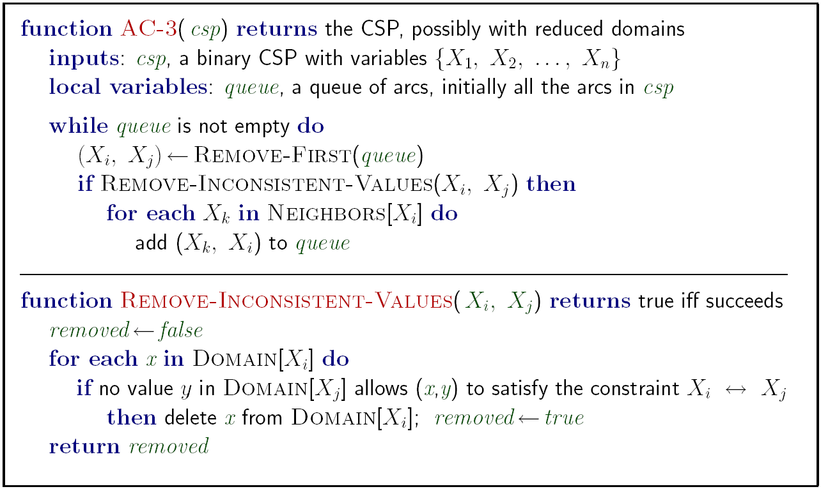
Enforcing Arc Consistency in a CSP
Notes:
Auto-consistency (note initially nothing gets deleted/pruned since there are consistent options for all constraints for initial variable domains)
Flashes whenever something needs to be re-checked

Slide 54
Arc Consistency of an Entire CSP
A simple form of propagation makes sure all arcs are consistent:
Queue:
SA->WA
NT->WA
NT
Q
WA
SA
NSW
V
Remember: Delete from the tail!

Slide 55
Arc Consistency of an Entire CSP
A simple form of propagation makes sure all arcs are consistent:
Queue:
NT->WA
WA->SA
NT->SA
Q->SA
NSW->SA
V->SA
NT
Q
WA
SA
NSW
V
Remember: Delete from the tail!

Slide 56
Arc Consistency of an Entire CSP
A simple form of propagation makes sure all arcs are consistent:
Queue:
WA->SA
NT->SA
Q->SA
NSW->SA
V->SA
WA->NT
SA->NT
Q->NT
NT
Q
WA
SA
NSW
V
Remember: Delete from the tail!

Slide 57
Arc Consistency of an Entire CSP
A simple form of propagation makes sure all arcs are consistent:
Queue:
WA->SA
NT->SA
Q->SA
NSW->SA
V->SA
WA->NT
SA->NT
Q->NT
NT
Q
WA
SA
NSW
V
Remember: Delete from the tail!

Slide 58
Arc Consistency of an Entire CSP
A simple form of propagation makes sure all arcs are consistent:
Queue:
NT->SA
Q->SA
NSW->SA
V->SA
WA->NT
SA->NT
Q->NT
NT
Q
WA
SA
NSW
V
Remember: Delete from the tail!

Slide 59
Arc Consistency of an Entire CSP
A simple form of propagation makes sure all arcs are consistent:
Queue:
Q->SA
NSW->SA
V->SA
WA->NT
SA->NT
Q->NT
NT
Q
WA
SA
NSW
V
Remember: Delete from the tail!

Slide 60
Arc Consistency of an Entire CSP
A simple form of propagation makes sure all arcs are consistent:
Queue:
NSW->SA
V->SA
WA->NT
SA->NT
Q->NT
NT
Q
WA
SA
NSW
V
Remember: Delete from the tail!

Slide 61
Arc Consistency of an Entire CSP
A simple form of propagation makes sure all arcs are consistent:
Queue:
NT
NT
Q
Q
WA
WA
SA
SA
NSW
NSW
V
V
Remember: Delete from the tail!

Slide 62
POLL: What gets added to the Queue?
A simple form of propagation makes sure all arcs are consistent:
Queue:
NT
A: NSW->Q, SA->Q, NT->Q
B: Q->NSW, Q->SA, Q->NT
NT
Q
Q
WA
WA
SA
SA
NSW
NSW
V
V

Slide 63
Arc Consistency of an Entire CSP
A simple form of propagation makes sure all arcs are consistent:
Queue:
NT->Q
SA->Q
NSW->Q
NT
NT
Q
Q
WA
WA
SA
SA
NSW
NSW
V
V
Remember: Delete from the tail!

Slide 64
Arc Consistency of an Entire CSP
A simple form of propagation makes sure all arcs are consistent:
Queue:
SA->Q
NSW->Q
WA->NT
SA->NT
Q->NT
NT
NT
Q
Q
WA
WA
SA
SA
NSW
NSW
V
V
Remember: Delete from the tail!

Slide 65
Arc Consistency of an Entire CSP
A simple form of propagation makes sure all arcs are consistent:
Queue:
NSW->Q
WA->NT
SA->NT
Q->NT
WA->SA
NT->SA
Q->SA
NSW->SA
V->SA
NT
NT
Q
Q
WA
WA
SA
SA
NSW
NSW
V
V
Remember: Delete from the tail!

Slide 66
Arc Consistency of an Entire CSP
A simple form of propagation makes sure all arcs are consistent:
Queue:
WA->NT
SA->NT
Q->NT
WA->SA
NT->SA
Q->SA
NSW->SA
V->SA
V->NSW
Q->NSW
SA->NSW
NT
NT
Q
Q
WA
WA
SA
SA
NSW
NSW
V
V
Remember: Delete from the tail!

Slide 67
Arc Consistency of an Entire CSP
A simple form of propagation makes sure all arcs are consistent:
Queue:
WA->NT
SA->NT
Q->NT
WA->SA
NT->SA
Q->SA
NSW->SA
V->SA
V->NSW
Q->NSW
SA->NSW
NT
NT
Q
Q
WA
WA
SA
SA
NSW
NSW
V
V
Remember: Delete from the tail!

Slide 68
Arc Consistency of an Entire CSP
A simple form of propagation makes sure all arcs are consistent:
Queue:
SA->NT
Q->NT
WA->SA
NT->SA
Q->SA
NSW->SA
V->SA
V->NSW
Q->NSW
SA->NSW
NT
NT
Q
Q
WA
WA
SA
SA
NSW
NSW
V
V
Remember: Delete from the tail!

Slide 69
Arc Consistency of an Entire CSP
A simple form of propagation makes sure all arcs are consistent:
Queue:
SA->NT
Q->NT
WA->SA
NT->SA
Q->SA
NSW->SA
V->SA
V->NSW
Q->NSW
SA->NSW
NT
NT
Q
Q
WA
WA
SA
SA
NSW
NSW
V
V
!!!
Remember: Delete from the tail!

Slide 70
Arc Consistency of an Entire CSP
A simple form of propagation makes sure all arcs are consistent:
Backtrack on the assignment of Q
Arc consistency detects failure earlier than forward checking
Can be run as a preprocessor or after each assignment
What’s the downside of enforcing arc consistency?
Queue:
SA->NT
Q->NT
WA->SA
NT->SA
Q->SA
NSW->SA
V->SA
V->NSW
Q->NSW
SA->NSW
NT
NT
Q
Q
WA
WA
SA
SA
NSW
NSW
V
V
Remember: Delete from the tail!

Slide 71
Enforcing Arc Consistency in a CSP
Runtime: O(n²d³), can be reduced to O(n²d²)
… but detecting all possible future problems is NP-hard – why?
Notes:
Auto-consistency (note initially nothing gets deleted/pruned since there are consistent options for all constraints for initial variable domains)
Flashes whenever something needs to be re-checked

Slide 72
Limitations of Arc Consistency
After enforcing arc consistency:
Can have one solution left
Can have multiple solutions left
Can have no solutions left (and not know it)
Arc consistency still runs inside a backtracking search!
What went wrong here?
[Demo: coloring -- forward checking]
[Demo: coloring -- arc consistency]
Notes:
Demo:
CS188 javascript demos -> source -> exercises -> csps -> CSPs demos -> CSPs demos.html
Settings:
Graph = Complex
Algorithm = Backtracking
Ordering = None
Filtering = Forward Checking (first) / Arc Consistency (second)

Slide 73
Demo Coloring – Backtracking with Forward Checking – Complex Graph

Slide 74
Demo Coloring – Backtracking with Arc Consistency – Complex Graph

Slide 75

Ordering

Slide 76
Demo: Coloring -- Backtracking + Forward Checking (+ MRV)
Notes:
Demo:
CS188 javascript demos -> source -> exercises -> csps -> CSPs demos -> CSPs demos.html
Settings:
Graph = Complex
Algorithm = Backtracking
Ordering = MRV
Filtering = Forward Checking
Solves already without any need for backtracking
Note: need a bigger problem to illustrate relevance of backtracking+AC+MRV+MCV

Slide 77

Ordering: Minimum Remaining Values
Variable Ordering: Minimum remaining values (MRV):
Choose the variable with the fewest legal left values in its domain
Why min rather than max?
Also called “most constrained variable”
“Fail-fast” ordering

Slide 78
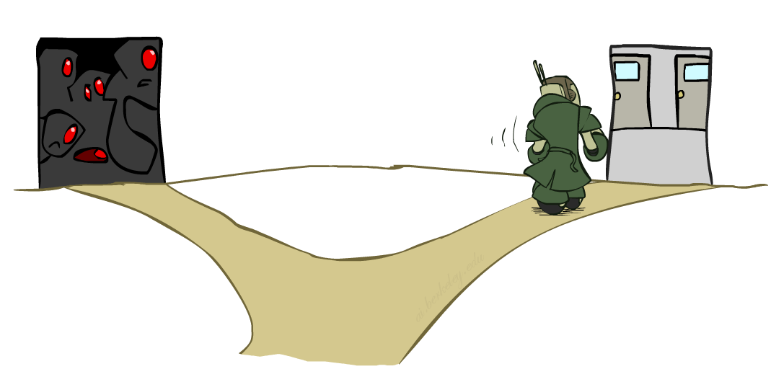
Ordering: Least Constraining Value
Value Ordering: Least Constraining Value
Given a choice of variable, choose the least constraining value
I.e., the one that rules out the fewest values in the remaining variables
Note that it may take some computation to determine this! (E.g., rerunning filtering)
Why least rather than most?
Combining these ordering ideas makes
1000 queens feasible

Slide 79
Demo: Coloring -- Backtracking + Arc Consistency + Ordering
Notes:
Demo:
CS188 javascript demos -> source -> exercises -> csps -> CSPs demos -> CSPs demos.html
Settings:
Graph = Complex
Algorithm = Backtracking
Ordering = MRV
Filtering = Forward Checking
Solves already without any need for backtracking
Note: need a bigger problem to illustrate relevance of backtracking+AC+MRV+MCV

Slide 80
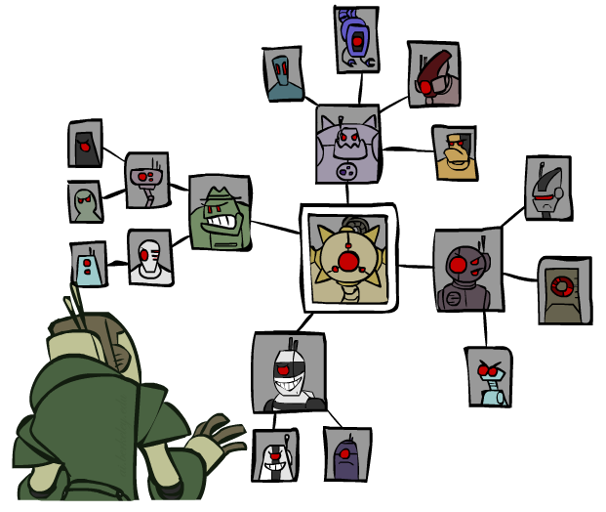
Structure

Slide 81
Problem Structure
Extreme case: independent subproblems
Example: Tasmania and mainland do not interact
Independent subproblems are identifiable as connected components of constraint graph
Suppose a graph of n variables can be broken into subproblems of only c variables:
Worst-case solution cost is O((n/c)(d^{c})), linear in n
E.g., n = 80, d = 2, c =20
2⁸⁰ = 4 billion years at 10 million nodes/sec
(4)(2²⁰) = 0.4 seconds at 10 million nodes/sec

Slide 82
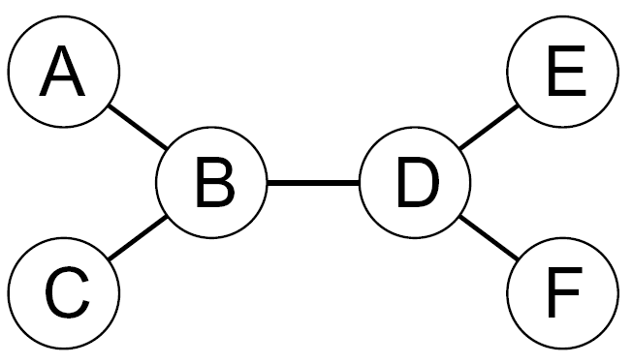
Tree-Structured CSPs
Theorem: if the constraint graph has no loops, the CSP can be solved in O(n d²) time
Compare to general CSPs, where worst-case time is O(d^{n})
This property also applies to probabilistic reasoning (later): an example of the relation between syntactic restrictions and the complexity of reasoning

Slide 83

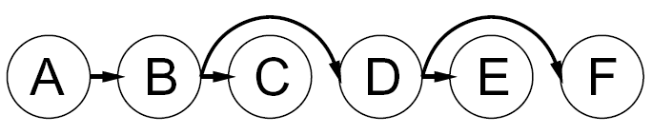

Tree-Structured CSPs
Algorithm for tree-structured CSPs:
Order: Choose a root variable, order variables so that parents precede children
Remove backward: For i = n : 2, apply RemoveInconsistent(Parent(X_{i}),X_{i})
Assign forward: For i = 1 : n, assign X_{i} consistently with Parent(X_{i})
Runtime: O(n d²) (why?)

Slide 84
Tree-Structured CSPs
Claim 1: After backward pass, all root-to-leaf arcs are consistent
Proof: Each X→Y was made consistent at one point and Y’s domain could not have been reduced thereafter (because Y’s children were processed before Y)
Claim 2: If root-to-leaf arcs are consistent, forward assignment will not backtrack
Proof: Induction on position
Why doesn’t this algorithm work with cycles in the constraint graph?
Note: we’ll see this basic idea again with Bayes’ nets

Slide 85
Summary: CSPs
CSPs are a special kind of search problem:
States are partial assignments
Goal test defined by constraints
Basic solution: backtracking search
Speed-ups:
Ordering
Filtering
Structure

